Slide 1

cesar Lozano, Harsimranjeet Singh, Enrique Ybarra

Slide 2
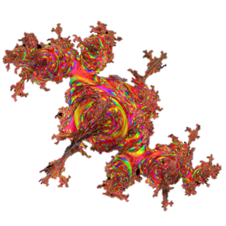
History of julia
Julia’s inception was in 2009
Lead developers Alan Edelman, Jeff Bezanson, Stefan Karpinski and Viral Shah started working on a language that could be used for better and faster numerical computing
Although some speculate that the language’s namesake is from a girlfriend or the Julia Set, it was recommended to Jeff Bezanson by a friend and they stuck with it
Julia 0.1.2 was released to the public on February 2012 as an open source language

Slide 3
What is Julia?
Julia is a high-level high-performance dynamic programming language for technical computing
Julia is a multi-paradigm language:
Object Oriented
Procedural
Functional
Meta
Multistaged

Slide 4
Where can I find Julia?
Current Release: V0.5.1
Julia is available for Windows, macOS, and Linux
You can use the command line version, JuliaBox.com, or JuliaPro (Juno IDE)
There are many ways to run Julia, you can even change it yourself due to it’s open source licensing

Slide 5
Julia in the workforce
Julia is widely known for it's extreme speed in computation
The ability to call on older code makes it very appealing to companies
It's most applicable industry use is in Data Science
Great for research in Academia as well
McAfee
Facebook
Capital One
Monsanto
Zulily
IBM
Forio
Symantec
Disney

Slide 6
How nice is Julia?
Pros (Writability and Reliability)
Cons (Readability and Cost)
Dynamic type system that is nearly as fast as statically typed languages (C)
You can call functions from C, Fortran, and even Python
Made for modern computer architectures
Writing is easy with extremely reliable performance
Julia assumes it's user base is full of experienced programmers
Still very new, with a small community building it slowly
Can easily become complex to read and the learning curve can be steep resulting in a mid to high cost if users are not experienced programmers

Slide 7
Julia Reserved Words
if | else | elseif | while | for | begin | end
try | catch | return | local | abstract | function | macro
ccall | finally | typealias | break | continue | type | global
module | using | import | export | const | let | bitstype
do | in | baremodule | importall | immutable | symbols

Slide 8
Data Types
-Julia uses dynamic typing (polymorphic language), but you can specify what type you would like to use.
- All arguments are passed by reference.
-Adding types results in faster and more reliable code.
-Type aliasing can be accomplished via typealias keyword.
-Can create composite types (objects) with the “type” keyword.
-Can union types into one type.
-You can declare your own bit types.
-And so much more, Julia is very flexible.

Slide 9
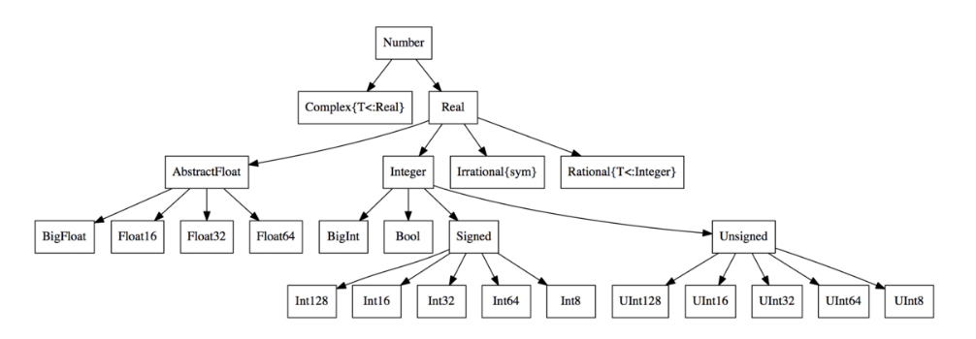
Types and their hierarchy:

Slide 10
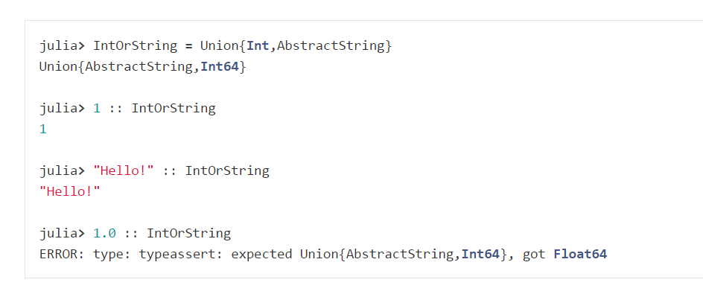
Union of Types

Slide 11
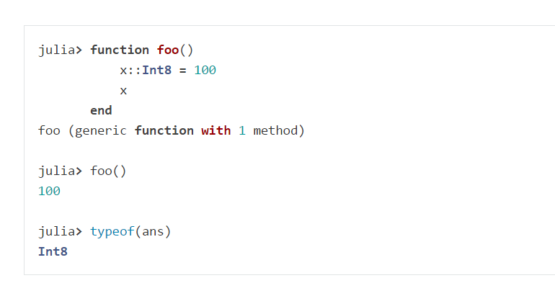
Specifying a Type

Slide 12
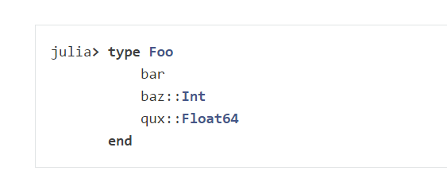
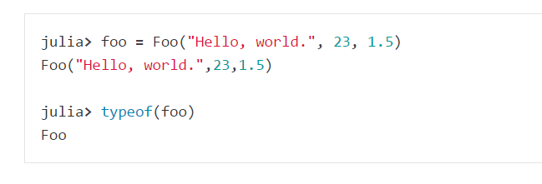
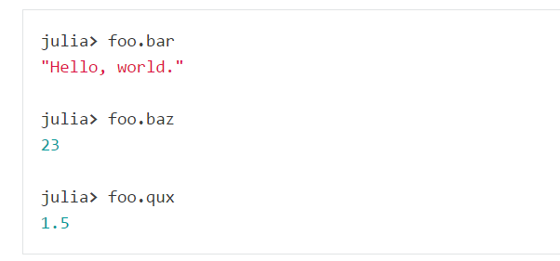
Composite Type Example:

Slide 13
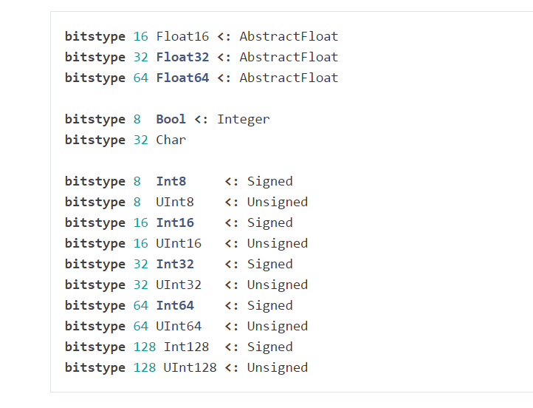
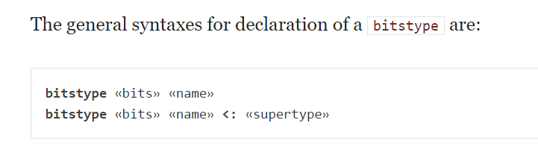
Bit Types

Slide 14
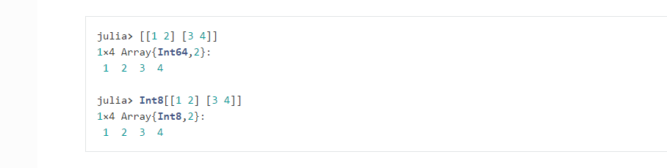
Arrays
Implemented almost entirely in Julia and get their performance from the compiler.
Can be multidimensional.
Declaring an array:

Slide 15
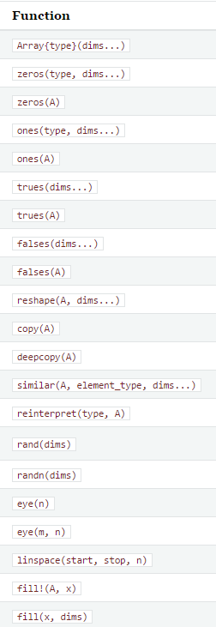
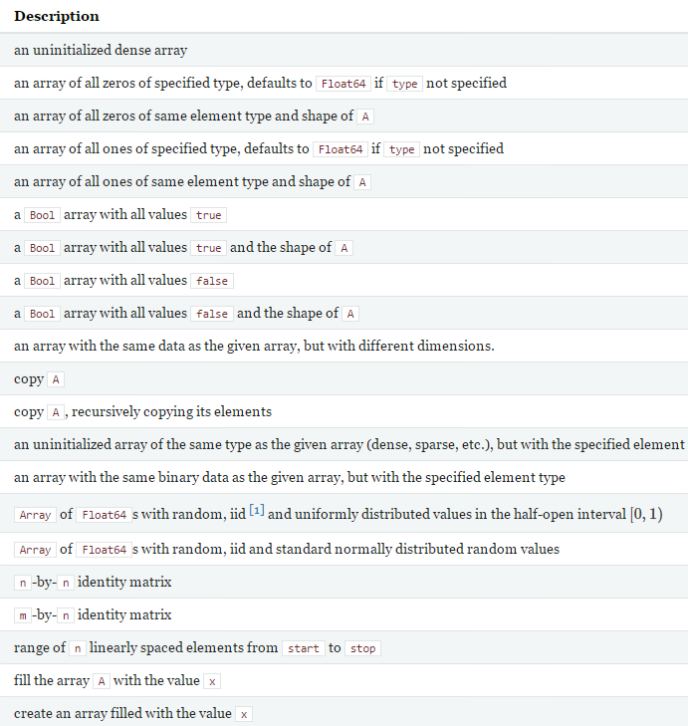

Slide 16
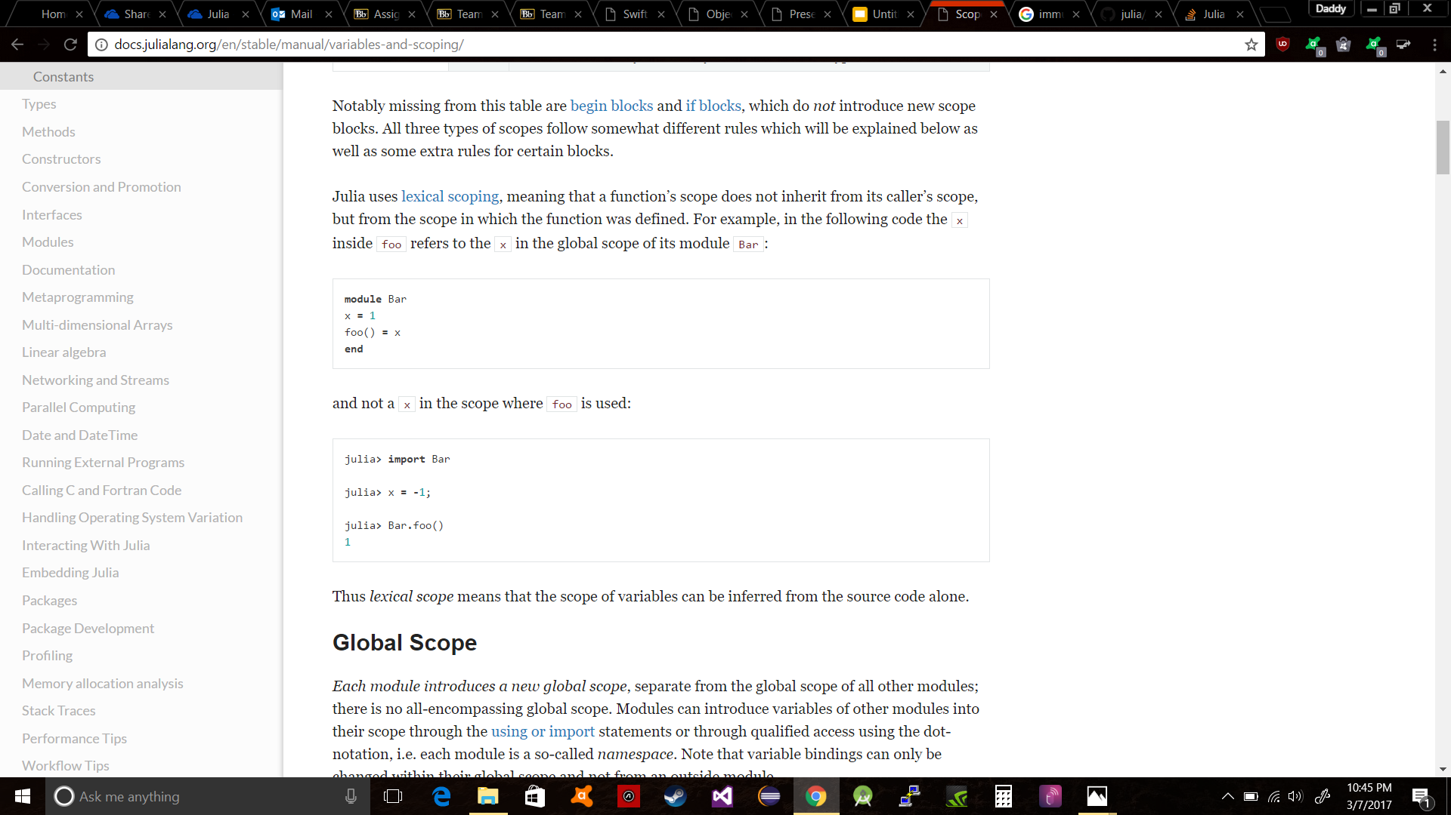
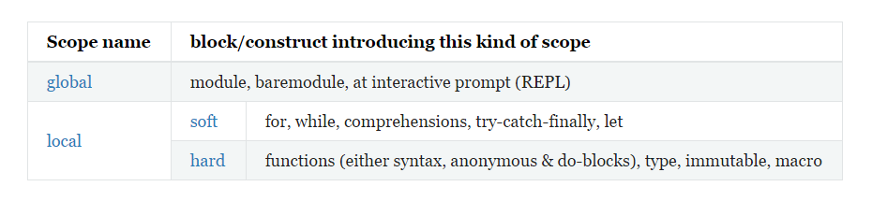
Scope
Julia uses lexical scoping, meaning that a function inherits the scope of where it was defined. Not the scope of the function where it was called.

Slide 17
Control Flow and Syntax

Slide 18
Control Flow Constructs:
Compound Expression: begin and semicolon (;)
Condition Evaluation: if, elseif, else, and ternary operator (?:)
Short Circuit Evaluation: &&, ||, and chained comparisons
Repeated Evaluation (Loops): while and for
Exception Handling: try, catch, error(), throw()
Tasks (Coroutines): yieldto()
Allows computations to be suspended and resumed later

Slide 19
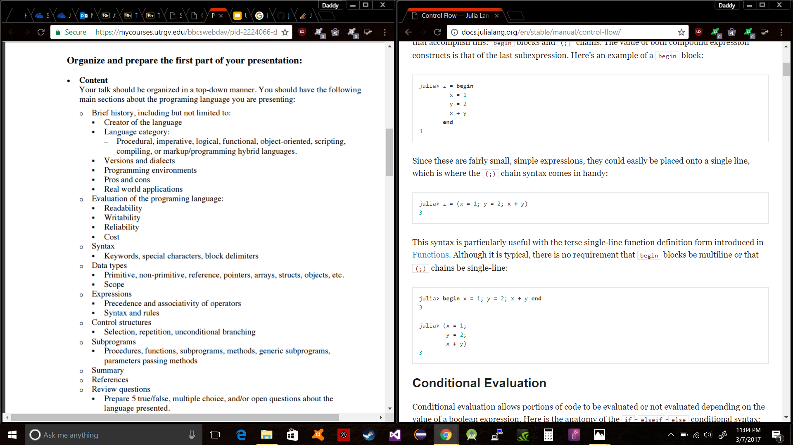
Compound Expressions

Slide 20
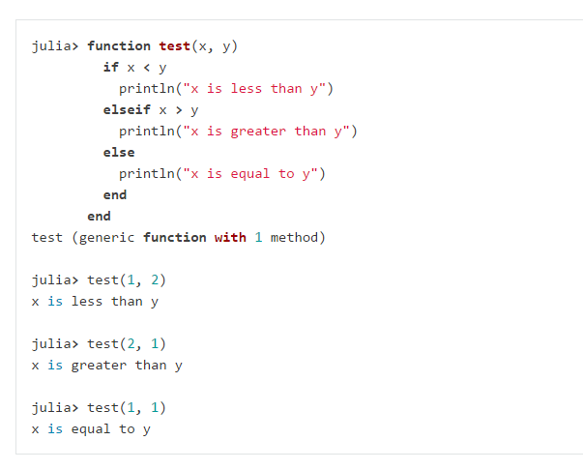
Conditional Evaluation

Slide 21
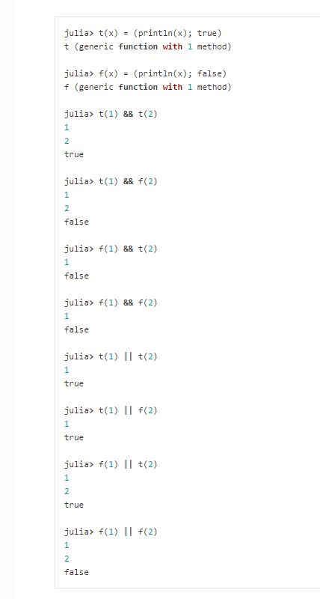
Short Circuit Evaluation

Slide 22
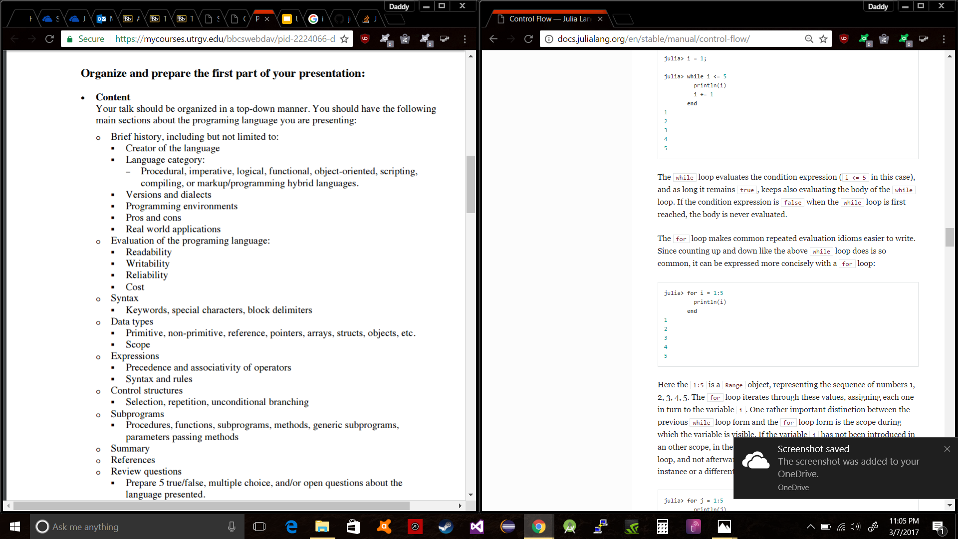
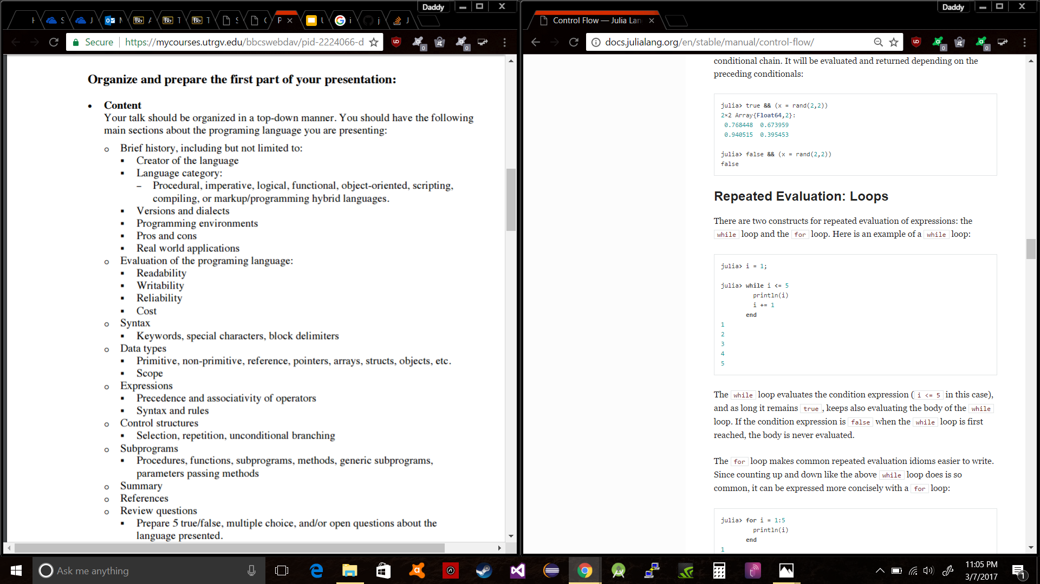
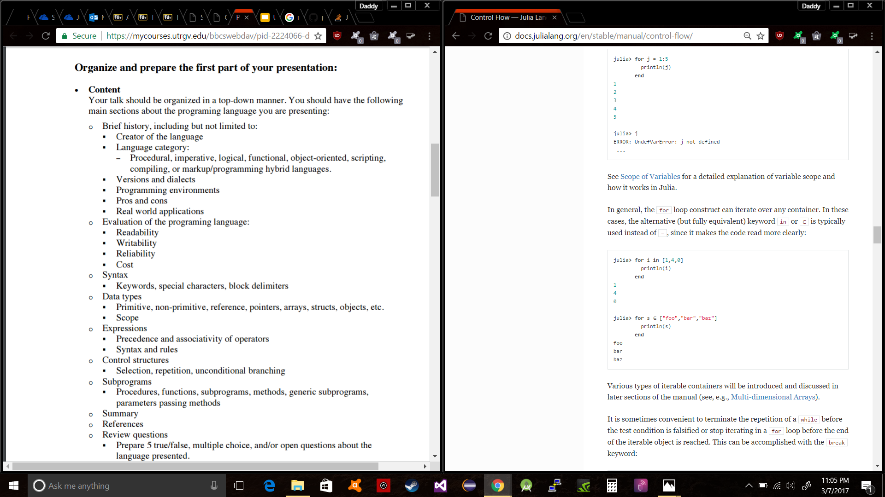
Repeated Evaluation

Slide 23
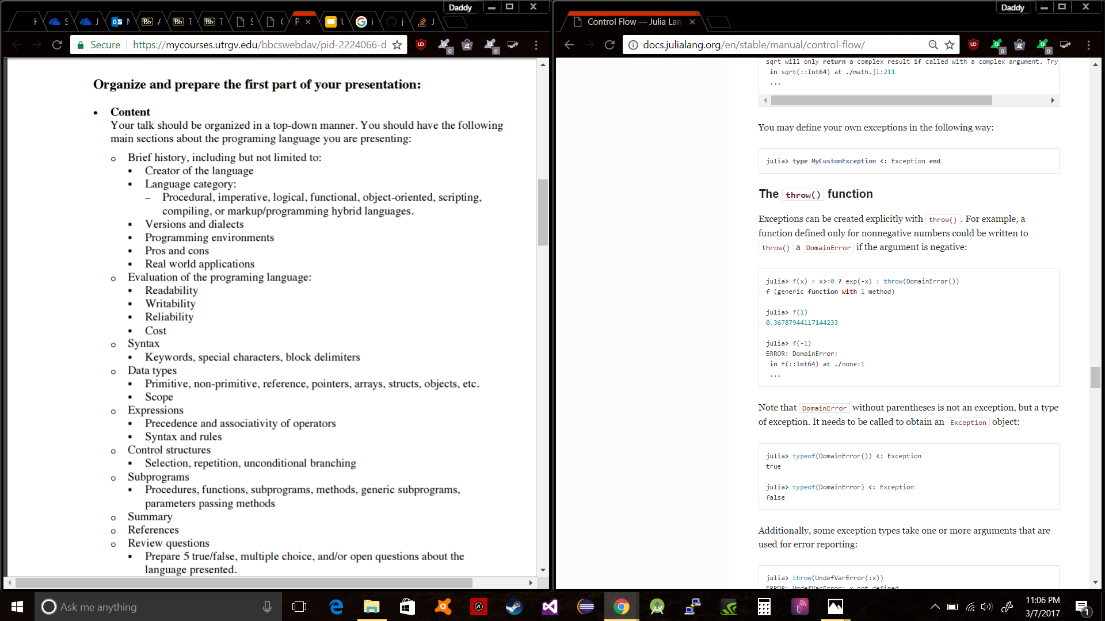
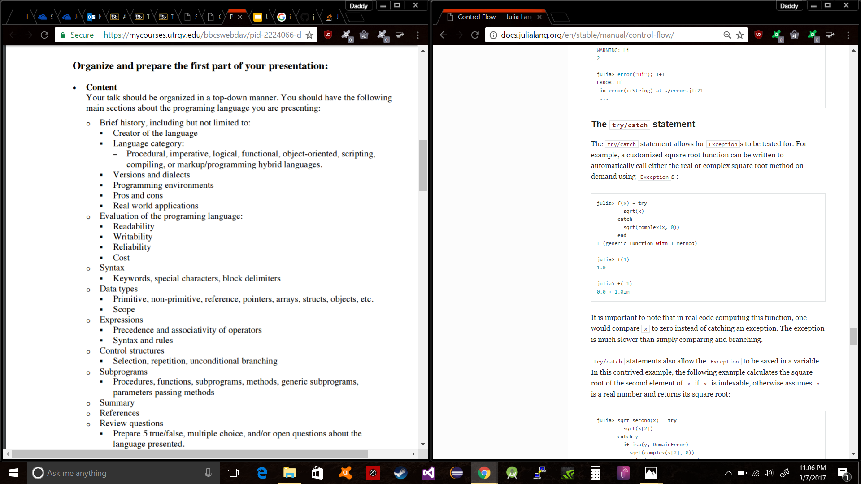
Exception Handling

Slide 24
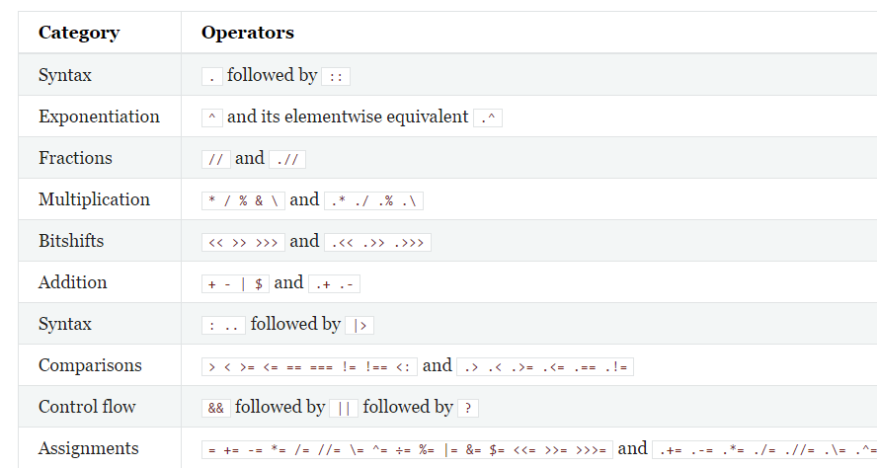
Operator Precedence
Julia follows mostly the same precedence as PEMDAS

Slide 25
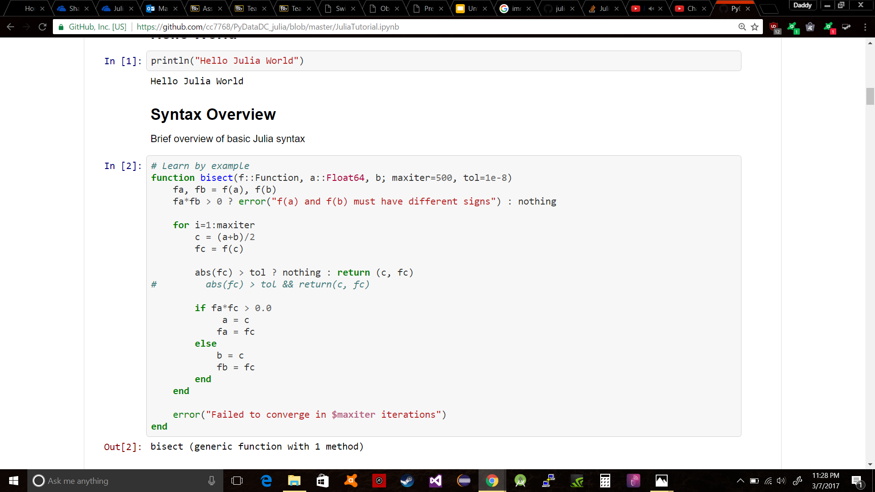
Function Highlighting Many Things and Syntax

Slide 26
Function
In Julia, a function is an object that maps a tuple of argument values to a return value. Julia functions are not pure mathematical functions, in the sense that functions can alter and be affected by the global state of the program. The basic syntax for defining functions in Julia is:
function f(x,y)
x + y
end
There is a second, more terse syntax for defining a function in Julia. The traditional function declaration syntax demonstrated above is equivalent to the following compact “assignment form
f(x,y) == x + y
In the assignment form, the body of the function must be a single expression, although it can be a compound expression. Short, simple function definitions are common in Julia
Julia>> f(2,3)
5

Slide 27
More about Functions
The value returned by a function is the value of the last expression evaluated, which, by default, is the last expression in the body of the function definition.
In Julia, most operators are just functions with support for special syntax. (The exceptions are operators with special evaluation semantics like && and ||. These operators cannot be functions.
In Julia, one returns a tuple of values to simulate returning multiple values. However, tuples can be created and destructured without needing parentheses, thereby providing an illusion that multiple values are being returned, rather than a single tuple value. For example, the following function returns a pair of values:
julia> 1 ++ 2 ++ 3
6
Julia>> +(1,2,3)
6
function foo(a,b)
return a + b, a * b
end

Slide 28
Argument Passing Behavior
Julia function arguments follow a convention sometimes called “pass-by-sharing”, which means that values are not copied when they are passed to functions. Function arguments themselves act as new variable bindings (new locations that can refer to values), but the values they refer to are identical to the passed values. Modifications to mutable values (such as Arrays) made within a function will be visible to the caller. This is the same behavior found in Scheme, most Lisps, Python, Ruby and Perl, among other dynamic languages.

Slide 29
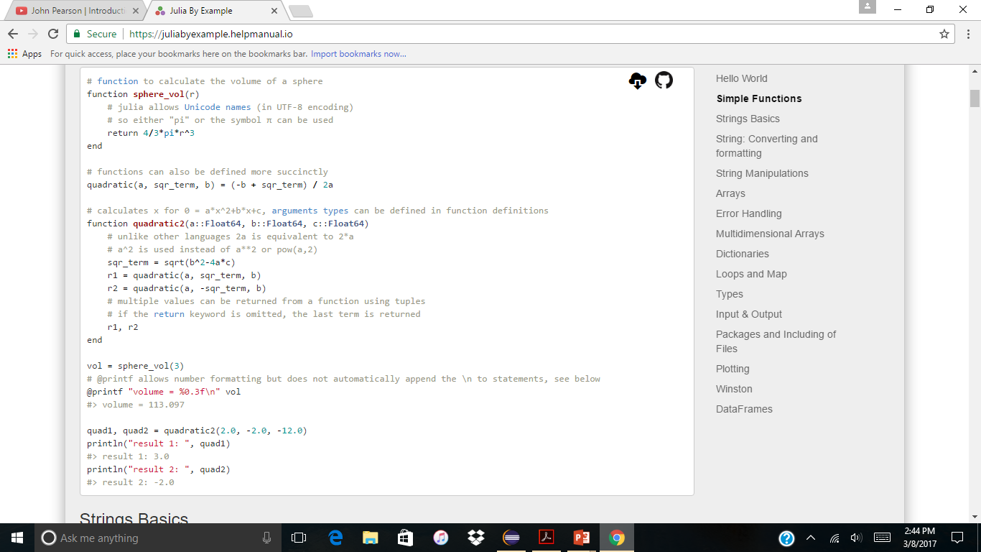
Subprogram
A subprogram is an encapsulation of a computation in some form that allows it to be executed from various points in a program, usually with parameters that represent the input to the computation. Examples are functions and procedures, at least one of which is found in almost all programming languages.
The program calculates the Volume of a sphere.
Julia Allows Unicode names such as pi.
To calculate the volume you can type in the exact expression , 4/3*pi*r^3

Slide 30
Procedures
Function can also be defined more succinctly
Arguments types can be defined in function definition. Example
Function quadraticc2(a::Float64.b::Float64, c:: Float64)
Multiple values can be returned from a function using tuples.
If the return keyword is omitted, the last term is returned.

Slide 31
Summary
Multiple dispatch: providing ability to define function behavior across many combinations of argument types
Dynamic type system: types for documentation, optimization, and dispatch
Good performance, approaching that of statically-compiled languages like C
Built-in package manager
Lisp-like macros and other metaprogramming facilities
Call Python functions: use the PyCall package
Call C functions directly: no wrappers or special APIs
Designed for parallelism and distributed computation
User-defined types are as fast and compact as built-ins
Automatic generation of efficient, specialized code for different argument types
Elegant and extensible conversions and promotions for numeric and other types
Efficient support for Unicode, including but not limited to UTF-8
MIT licensed: free and open source

Slide 32
Sources
http://bugman123.com/Hypercomplex/ - Julia Set Fractal Image
http://www.unixstickers.com/stickers/coding_stickers/julia-programming-language-logo-sticker - Julia Logo Image
https://www.cleverism.com/skills-and-tools/julia/ - Julia History
http://julialang.org/ - Julia Website
https://github.com/cc7768/PyDataDC_julia/blob/master/JuliaTutorial.ipynb

Slide 33
Review Questions
Who was the founder of Julia?
What kind of Language is Julia ?
What is the current version of Julia ?
Is statement endl part of Julia ? (True/False)
What does the following statement output when using Julia
3.0 + 5 ?

